Slide 1
CAMERA TRANSITIONS Personal Research – Project II
Roger Pérez Romera
CITM UPC Terrassa

Slide 2
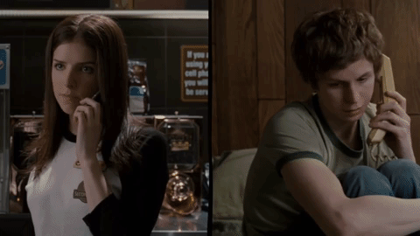
Theory: - What is a transition? - Types of transitions - Use of transitions Code: - Code structure
Scott Pilgrim vs The World

Slide 3
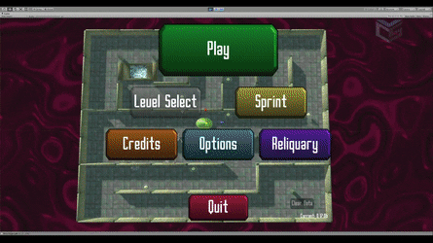
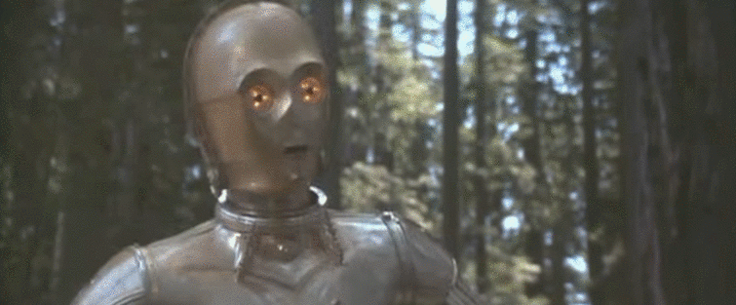
Theory – What is a transition?
Effect between a scene and the next one.
Create and produce an effect to the spectator.
Films, videogames, series…
Cinematic moments vs. menus and UI.
Star Wars
Sky Labyrinth

Slide 4
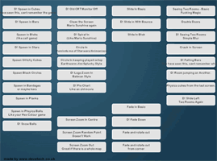
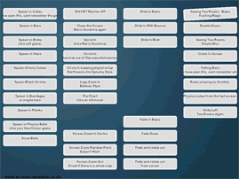
Theory - Types of transitions
Fade:
Slow
Tension
Importance
Cross - Fade:
Faster
Simple
Non-Aggressive

Slide 5
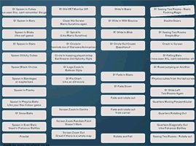
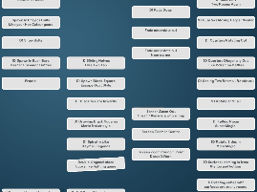
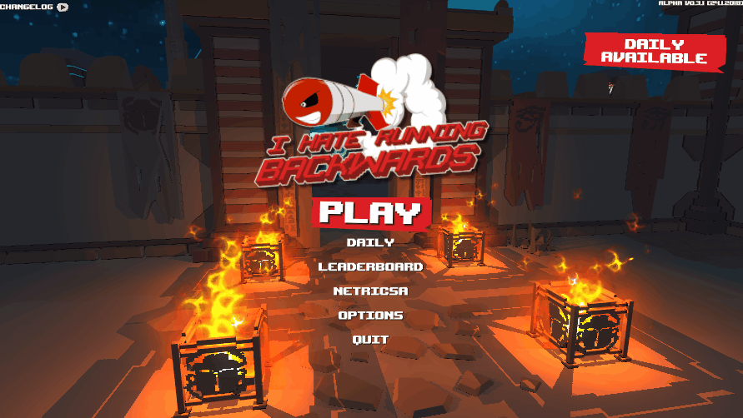
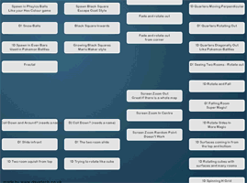
Theory - Types of transitions
Wipe:
Freedom
Emotional charge
Pan and Zoom:
Powerful
Dynamism
Action
I Hate Running Backwards

Slide 6
Theory - Use of transitions
The transitions you choose are important!
But for the game… transitions will give us time to:
Load a scene or level.
Keep the player immersed.
So we will do the change of scene during the transition.
Use the next links to get creative on your scenes transitions:
http://www.davetech.co.uk/screentransitions
https://www.youtube.com/watch?v=fKgvno6k-og

Slide 7
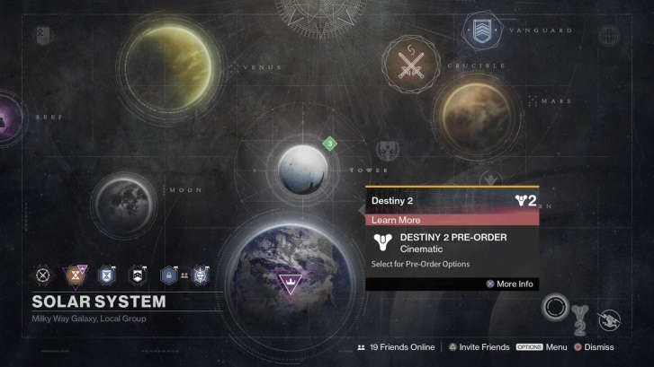
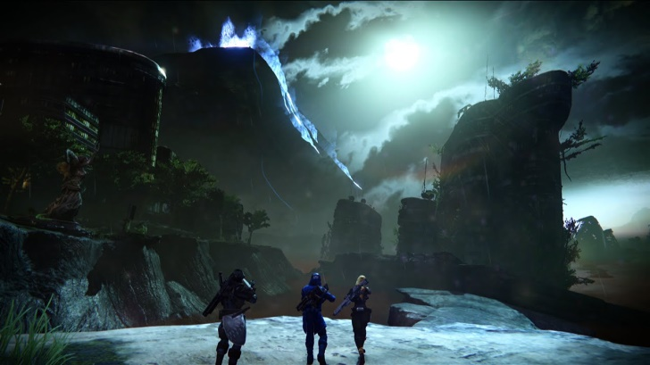
Code - Structure
Simple.
1 Module for the transitions(h/cpp).
Two scenes: Scene 1 and Scene 2.

Slide 8
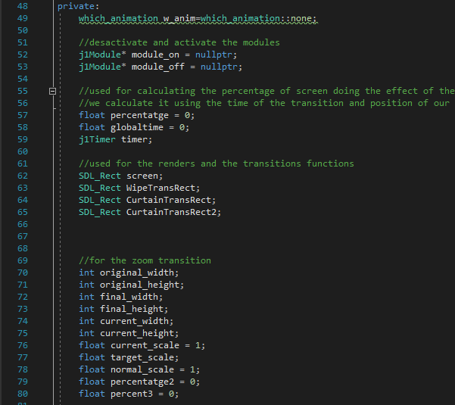
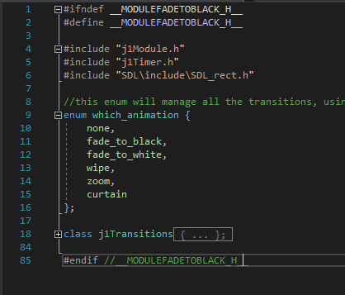
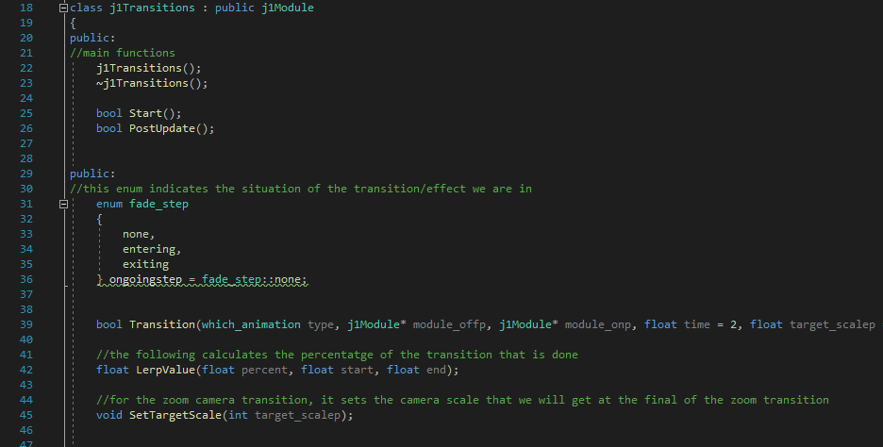
Code – Structure: Transitions.h
Enum which_animation: five types of
transitions.
class j1Transitions:
Main elements
Function Transition
Initialize variables for Transitions.cpp.

Slide 9
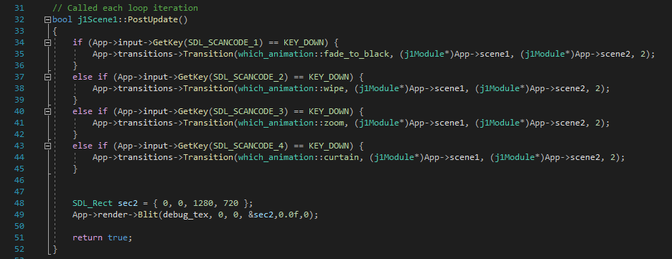
Code – Structure: Transitions.cpp and scenes
Two switch in the postUpdate:
One for the fade step
One for the blit of each transition.
Scene1 and Scene2:
Will call the function Transition given an input.
We must give: type of transition, scene to go off, next scene and time.

